Slide 1
Implementation of Shadow Mapping
Arvind Pandiyan<axp141630>
Nagabharan Nagendran<nxn141730>
The Unviersity of Texas at Dallas, 2015

Slide 2
Shadow Mapping
The shadow-map is rendered off-screen via an openGL Framebuffer Object (FBO).
Only depth value are saved during rendition, there is no color texture bound to the FBO and color writes are disabled via glColorMask(GL_FALSE, GL_FALSE, GL_FALSE, GL_FALSE).
We transform the vertex with the camera matrices, the same vertex with the light POV matrix and we get the fragment color.
The shadow variable holds the shadowed test result. As you see, the goal is to compare the z value (in light POV) of the vertex rendered, with what was rendered to the shadow-map.

Slide 3
Shadow Volume
A shadow volume is basically a cone capped on both ends.
The origin of the cone is the light source.
The cone is initially capped at the silhouette of an object and capped again at some other arbitrary place as long as the second capping results in a cone that passes though the ground plane.
The silhouette of an object is defined to be any edge of the object such that one side of the edge faces the light and the other side does not

Slide 4
Shadow Volume Algorithm
Draw Scene Normally
Turn off depth buffer and color buffer.
Enable writing to stencil buffer.
Draw Shadow polygons facing the eye. They increment values in stencil buffer.
Draw Shadow polygons not facing the eye. They decrement values in stencil buffer.
Disable writing to stencil buffer.
Turn on depth buffer and color buffer.
Draw Scene again but with the stencil buffer test and the lights off.

Slide 5
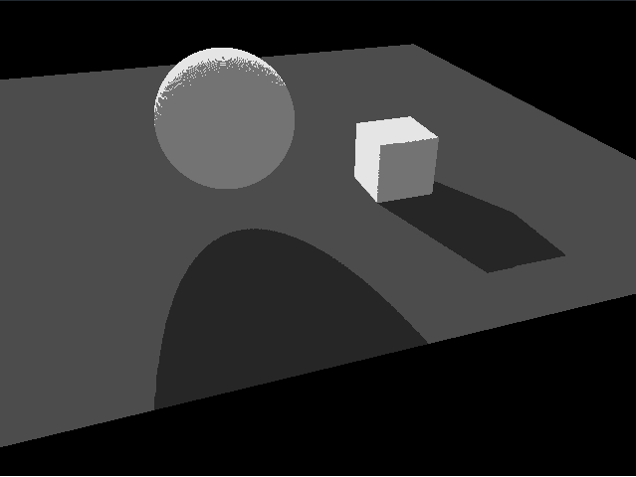
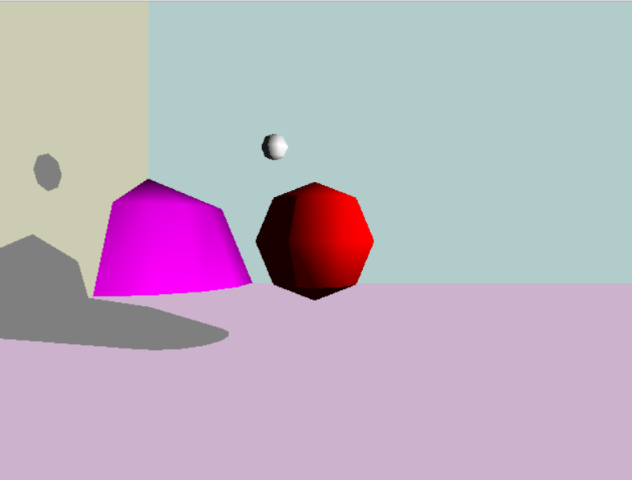
RESULTS
Shadow Mapping Shadow Volume

Slide 6
LIVE DEMO

